Slide 1
Big Data Final Project
By,
1- Dhananjay Panchal
2- Yadhavi Rao
3- Shubham Pawar
4- Nikhil Pawar
5- Jiazheng Yue

Slide 2
IBM AutoAI
AutoAI is a variation of AutoML. It extends the automation of model building to the entire AI lifecycle. Like AutoML, AutoAI applies intelligent automation to the steps of building predictive machine learning models. These steps include preparing data sets for training; identifying the best type of model for the given data, such as a classification or regression model; and choosing the columns of data that best support the problem the model is solving, known as feature selection. Automation then tests a variety of hyperparameter tuning options to reach the best result as it generates, and then ranks, model-candidate pipelines based on metrics such as accuracy and precision. The best performing pipelines can be put into production to process new data and deliver predictions based on the model training.
Reference- https://www.ibm.com/cloud/watson-studio/autoai

Slide 3
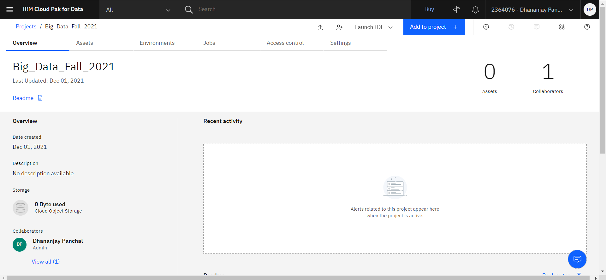
AutoAI- Add Project in the tab

Slide 4
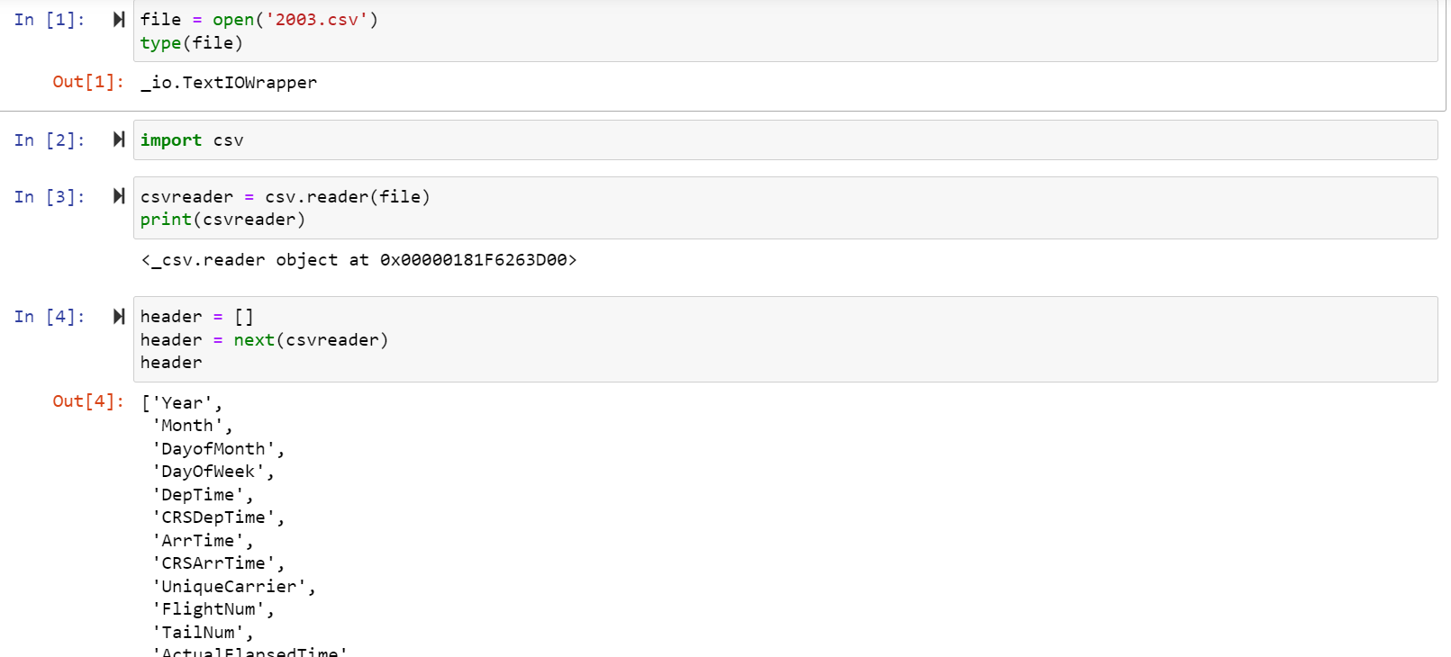

Slide 5
Task Performed by the team
1)Combined Data Set(1988,1999,2000,2003,2006,)
2)Training Dataset(50000 Random records of each year)
3)Testing Data set
Tools we used:
IBM AutoAI, Excel, Hive

Slide 6
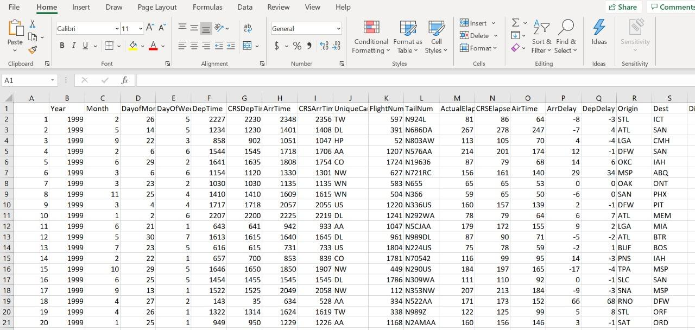
Merging of records in Excel and loading Data in excel.

Slide 7
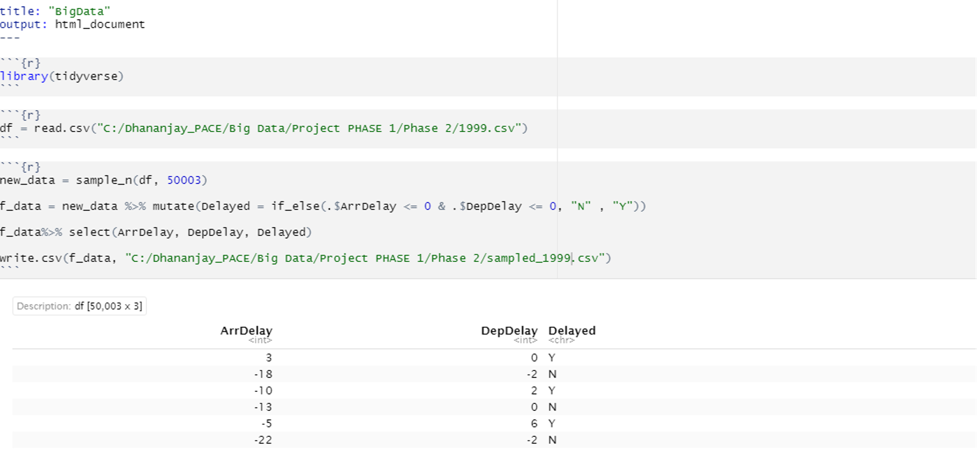

Slide 8
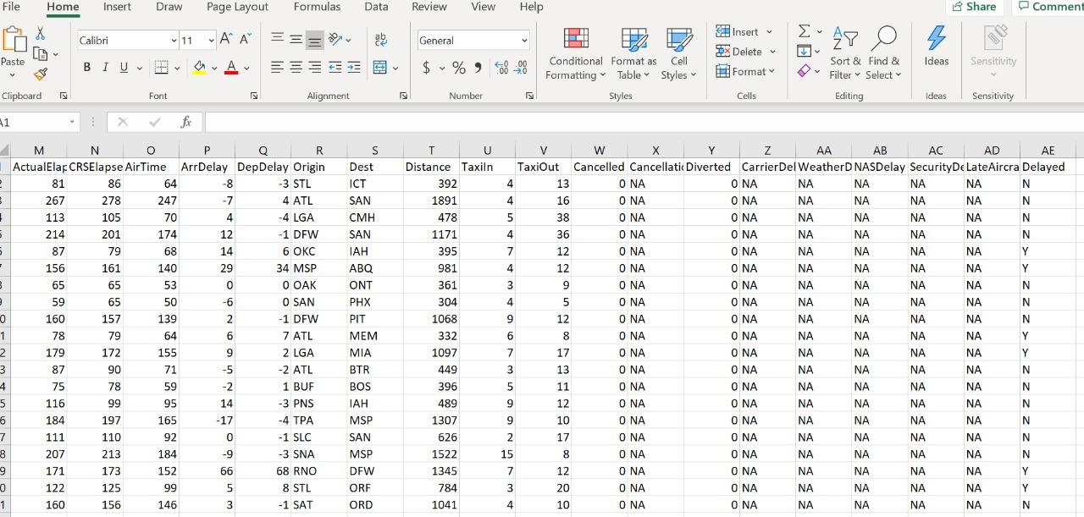
Combined years
Created a New Column “Delayed”
Populated the values for each table as per the logic,
a. Insert a “N” if the record has a value of zero and less than zero in the ArrDelay and DepDelay columns
b. Insert a “Y” otherwise

Slide 9
Algorithms Used –
1- Decision Tree Classifier 2- XGB Classifier
Decision tree classifier-
Maps observations about an item (represented in branches) to conclusions about the item’s target value (represented in leaves). Supports both binary and multiclass labels, as well as both continuous and categorical features.
XGB classifier-
Accurate sure procedure that can be used for classification problems. XGBoost models are used in a variety of areas including Web search ranking and ecology.

Slide 10
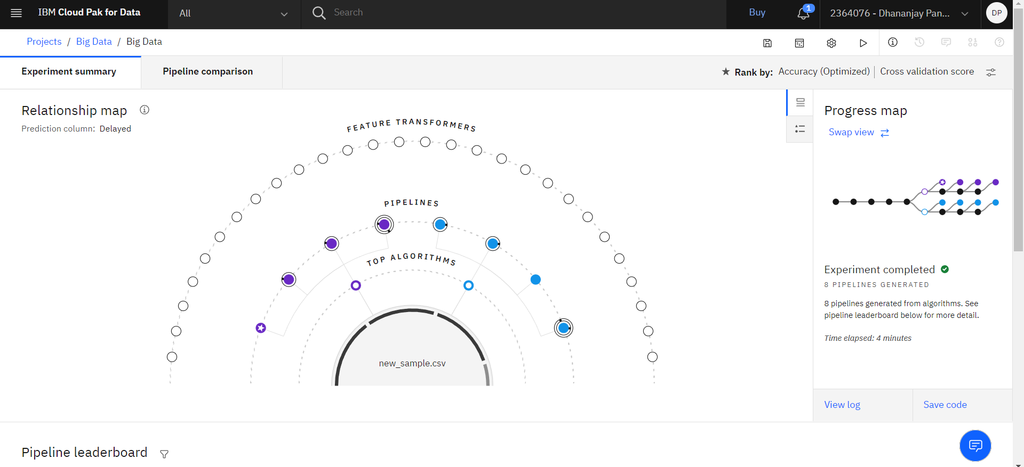
Pipeline Progress Map.

Slide 11
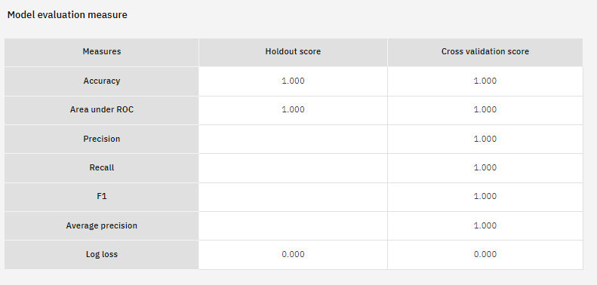
Model Evaluation.

Slide 12
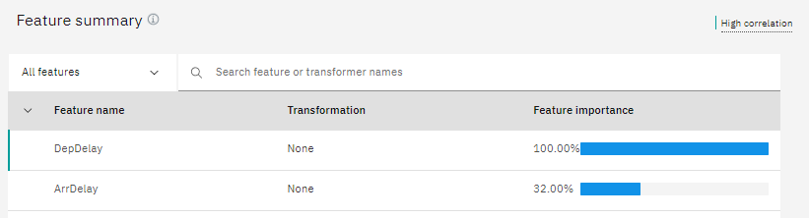
Decision Tree Classifier
Feature summary

Slide 13
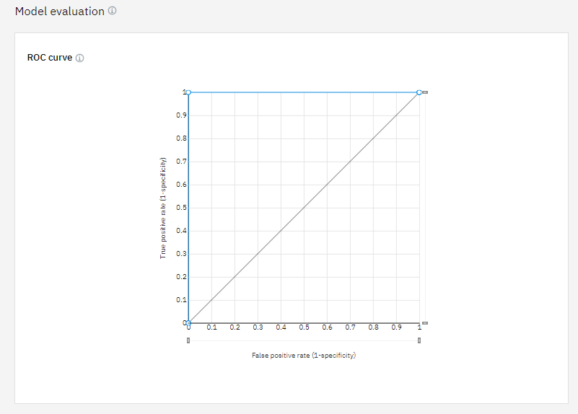
ROC Curve for Decision tree classifier-
An ROC curve is a graph showing the performance of a classification model at all classification thresholds

Slide 14
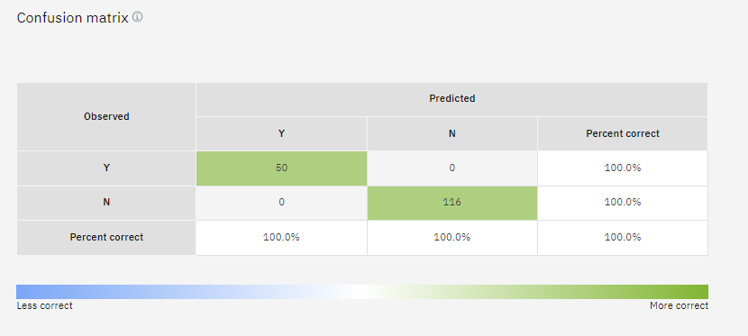
Confusion Matrix for Decision tree classifier

Slide 15
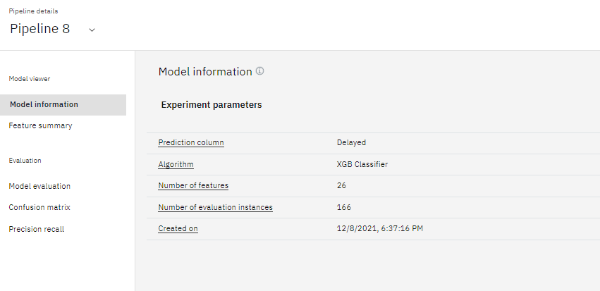
XGB Model Information

Slide 16
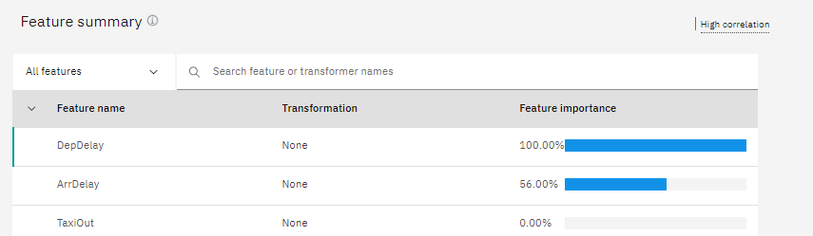
XGB Model
Feature summary

Slide 17
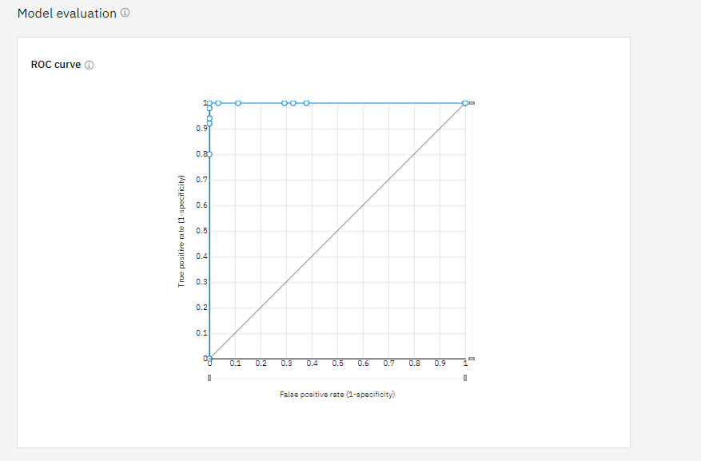
ROC Curve for XGB Model

Slide 18
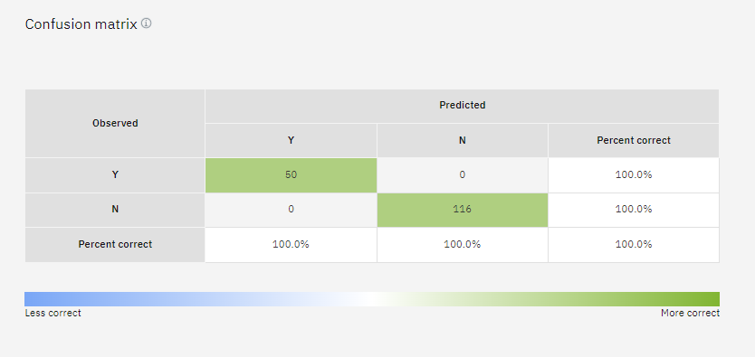
Confusion matrix for XGB Model

Slide 19
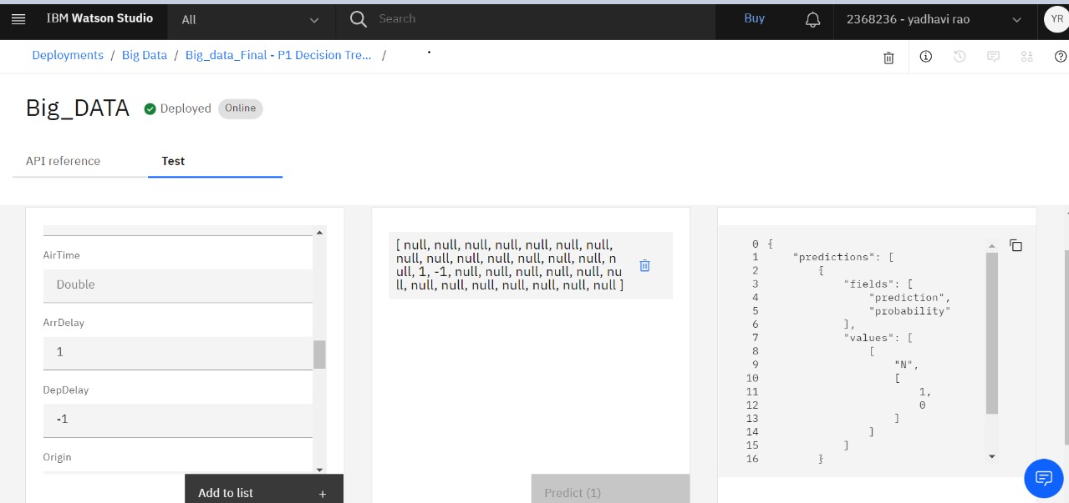
Deployment of data and giving input

Slide 20
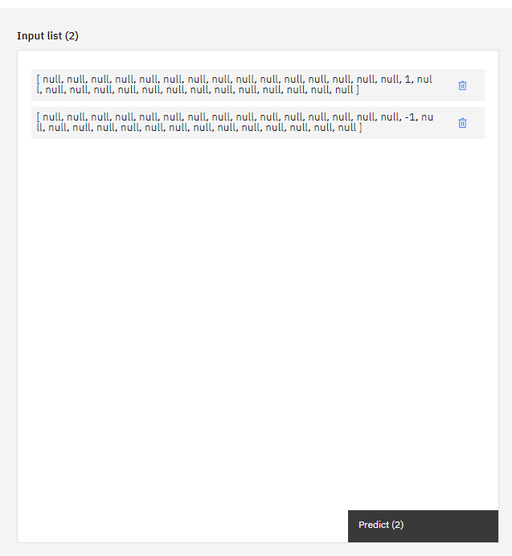
Input Lists

Slide 21
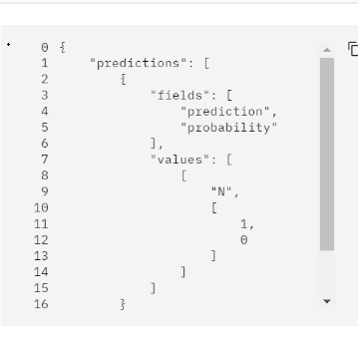
Result of the test

Slide 22
Rapid Miner
Provides an integrated environment for data preparation, machine learning, deep learning, text mining, and predictive analytics.
RapidMiner Studio is a visual data science workflow designer accelerating the prototyping & validation of models. Easy to use visual environment for building analytics processes: Graphical design environment makes it simple and fast to design better models.

Slide 23
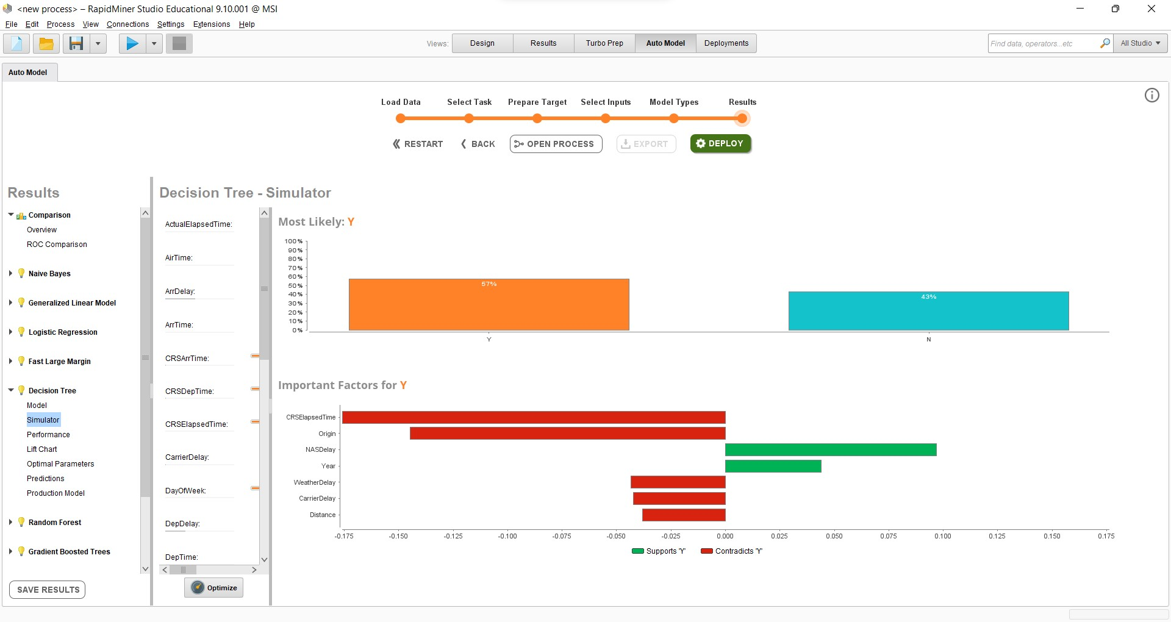
Decision Tree

Slide 24
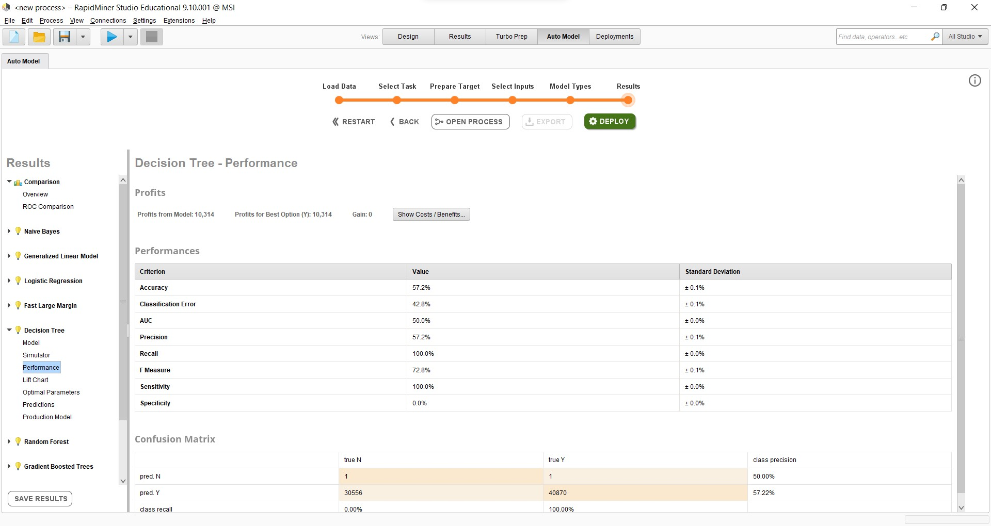

Slide 25
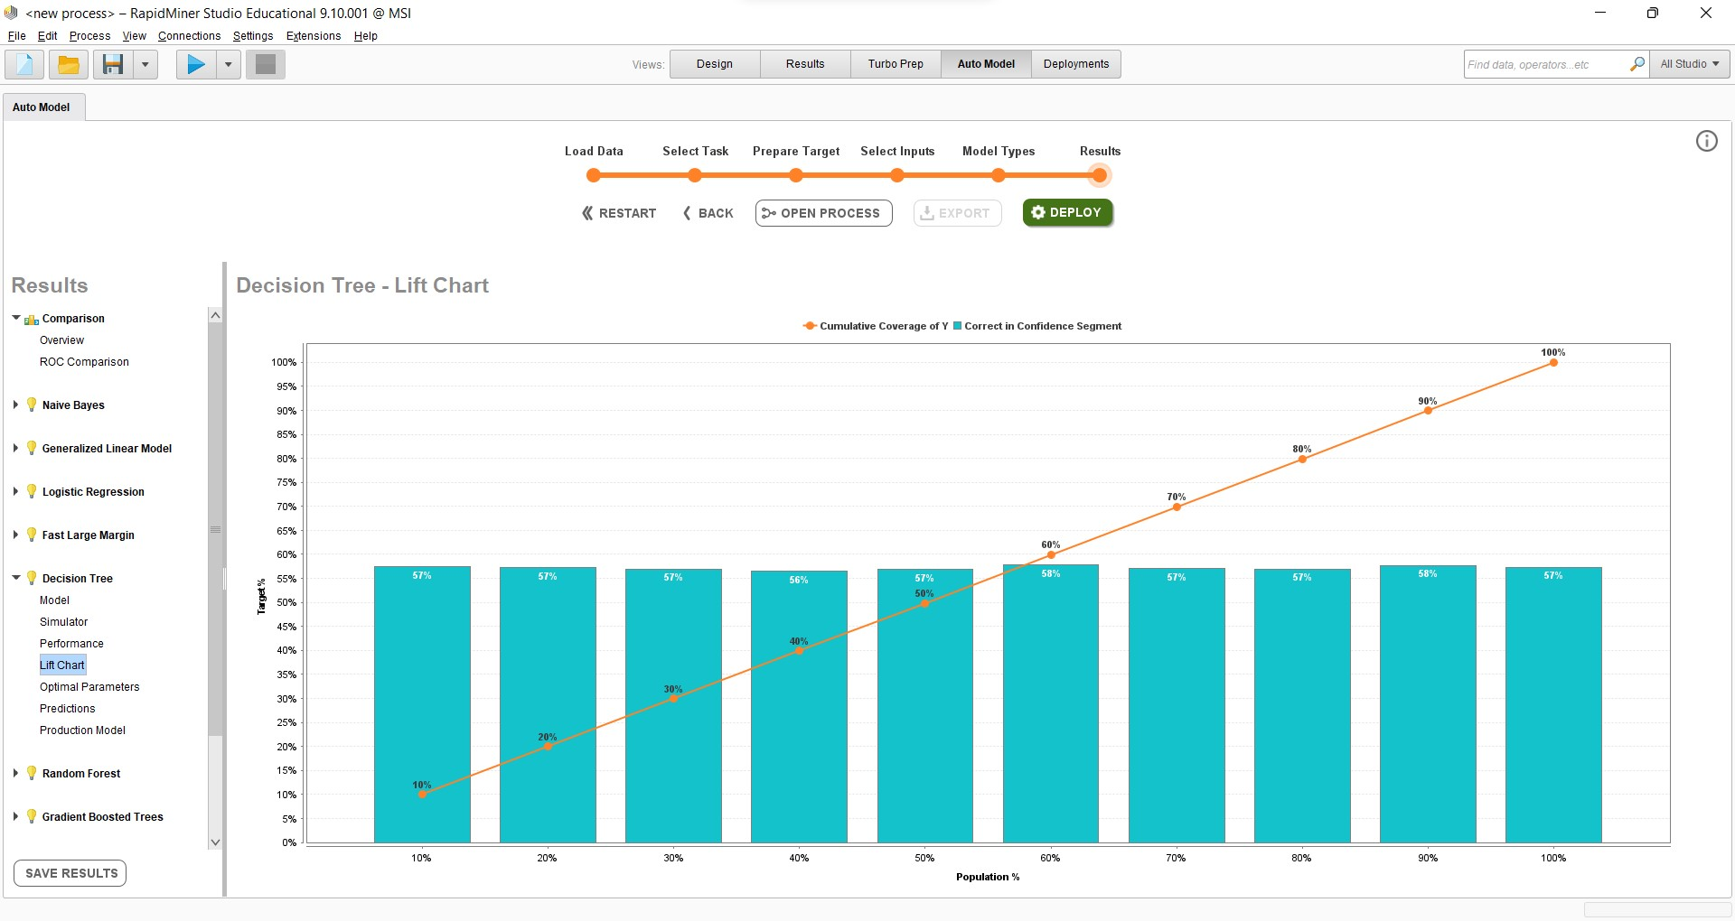

Slide 26
Fast Last Margin
Delivers similar results as of SVM or logistic regression implementations
this linear classifier can work on data set with millions of examples and attributes.

Slide 27
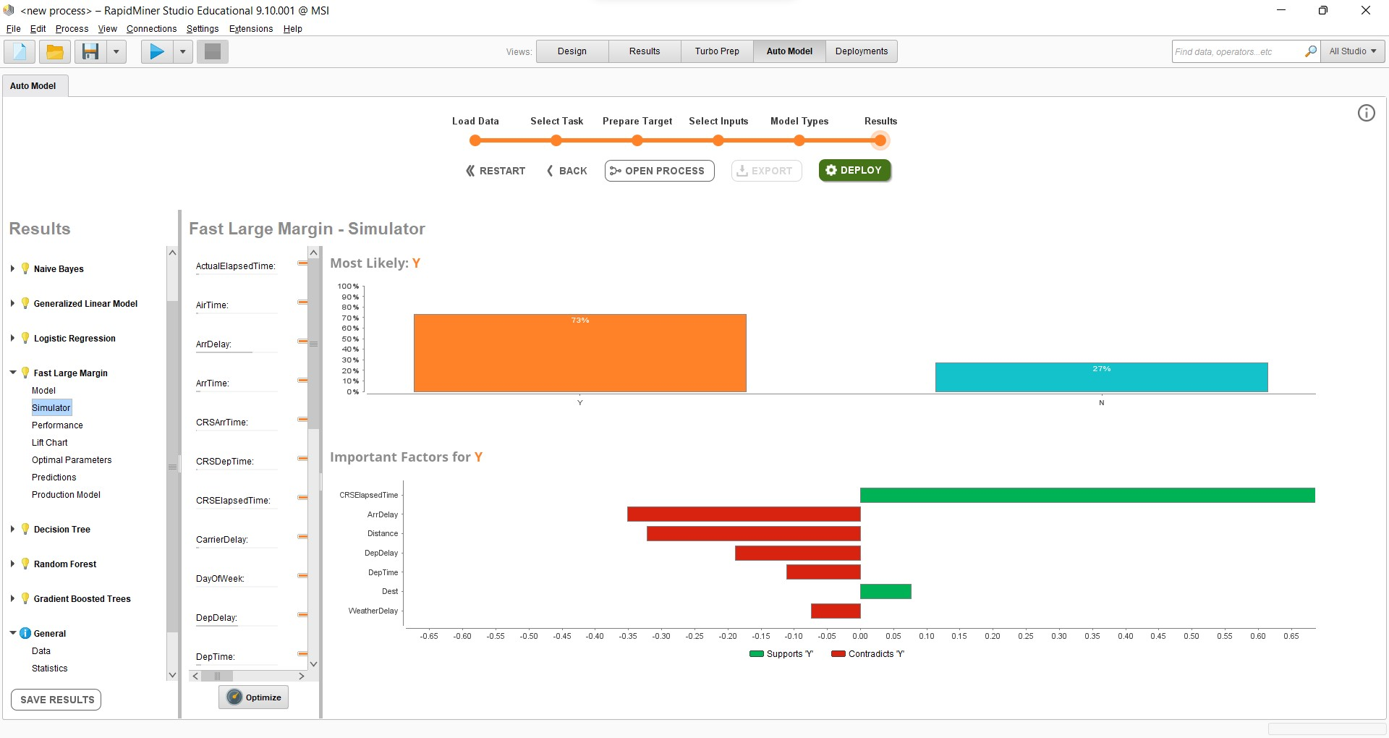
Fast Large Margin

Slide 28
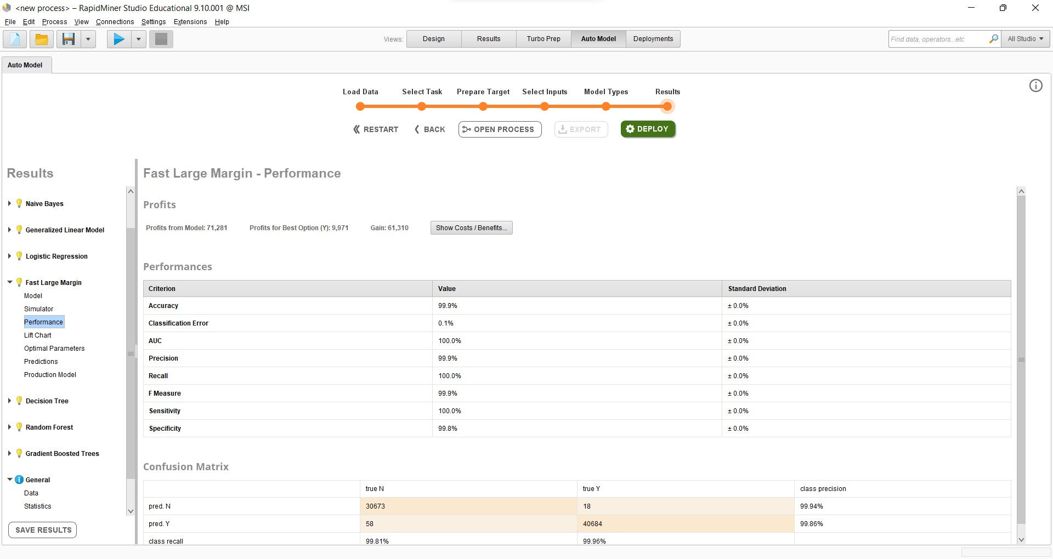

Slide 29
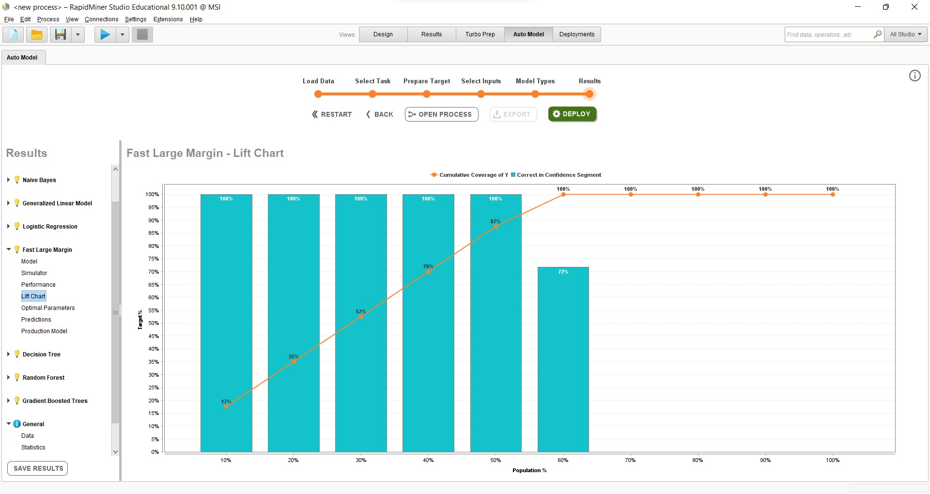

Slide 30
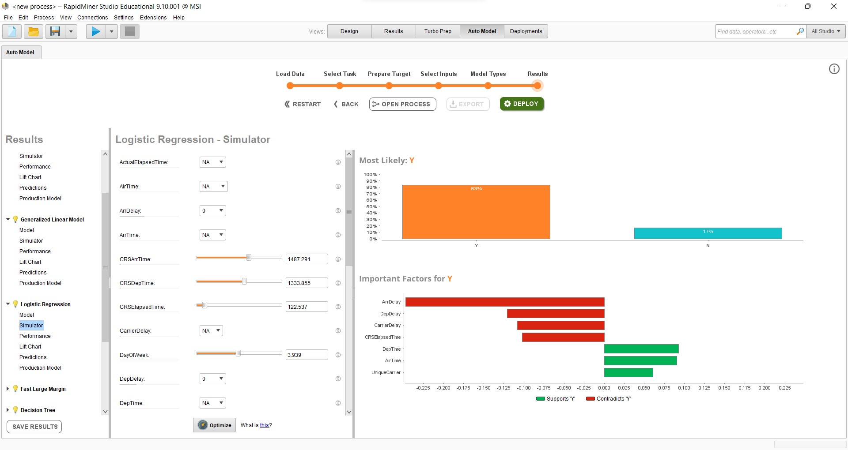
Logistic regression

Slide 31
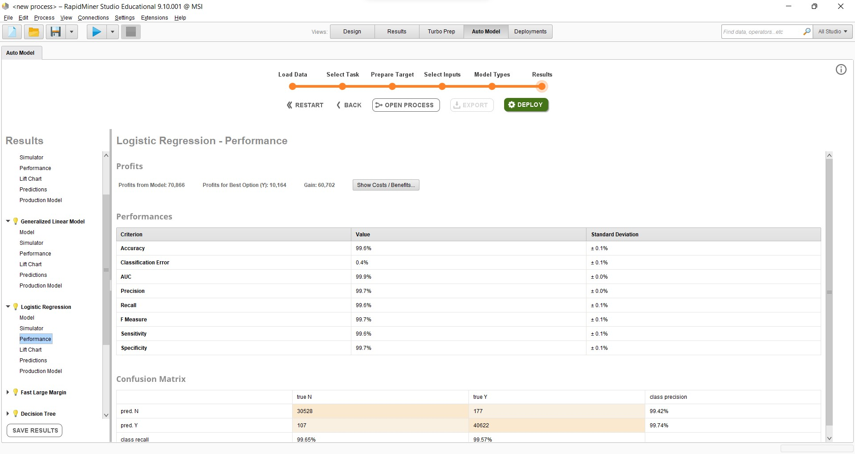

Slide 32
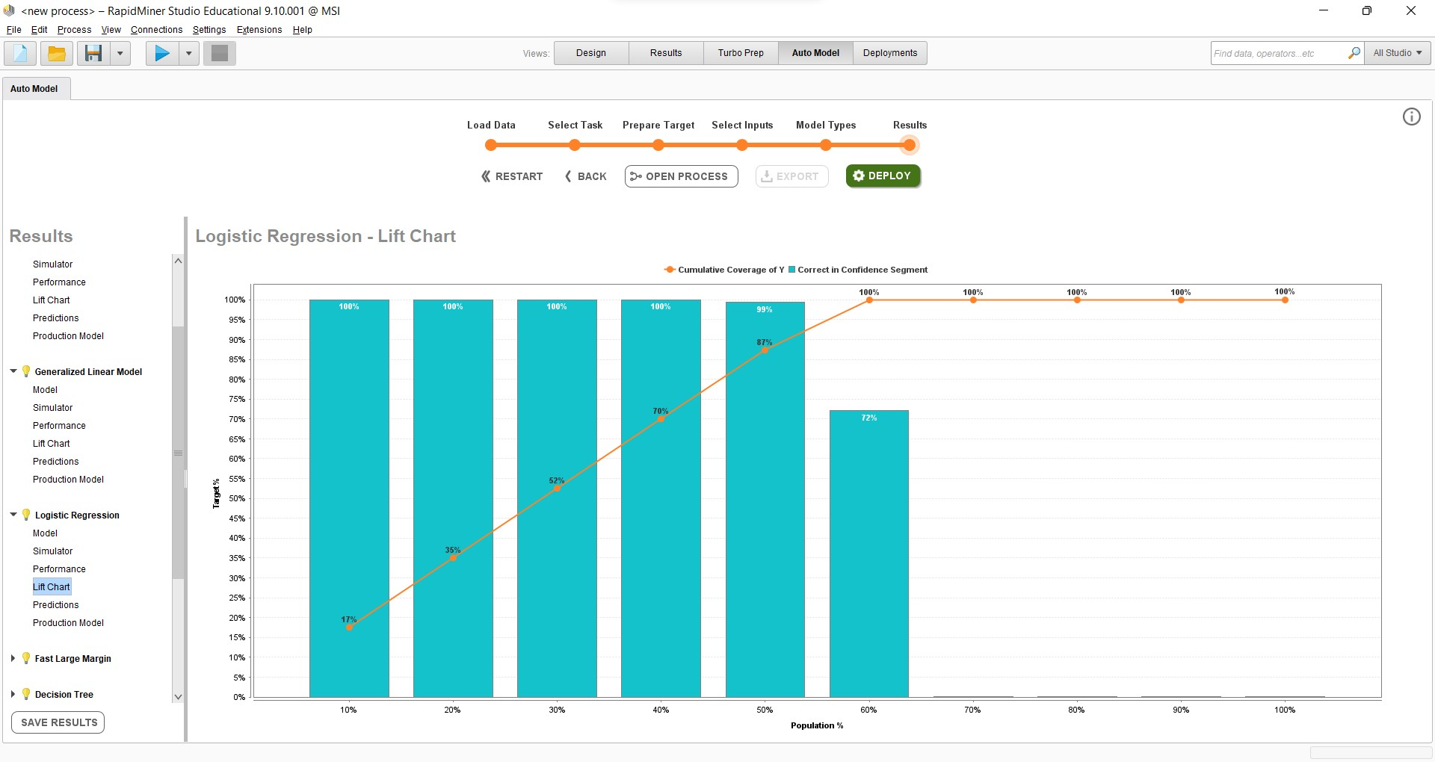

Slide 33
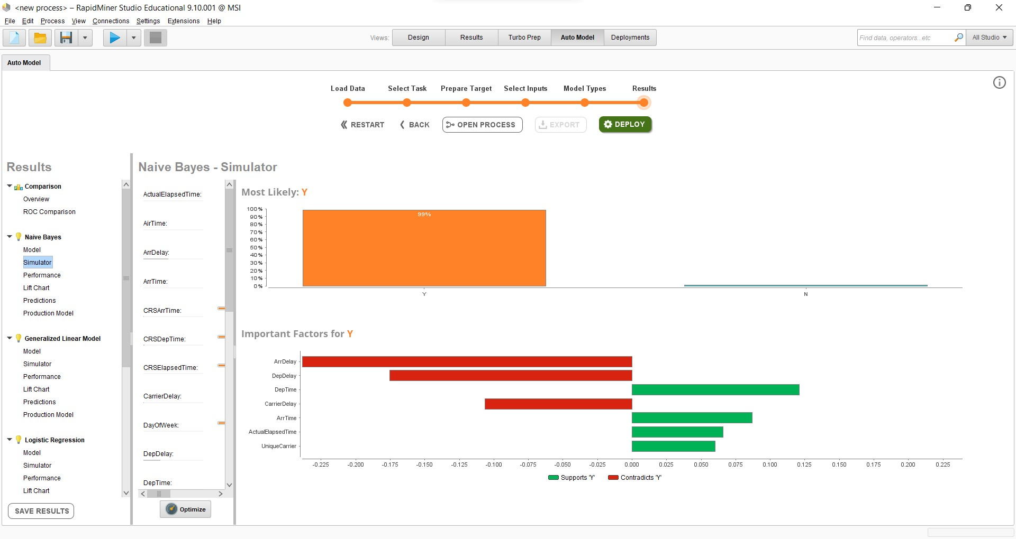
Naive Bayes

Slide 34
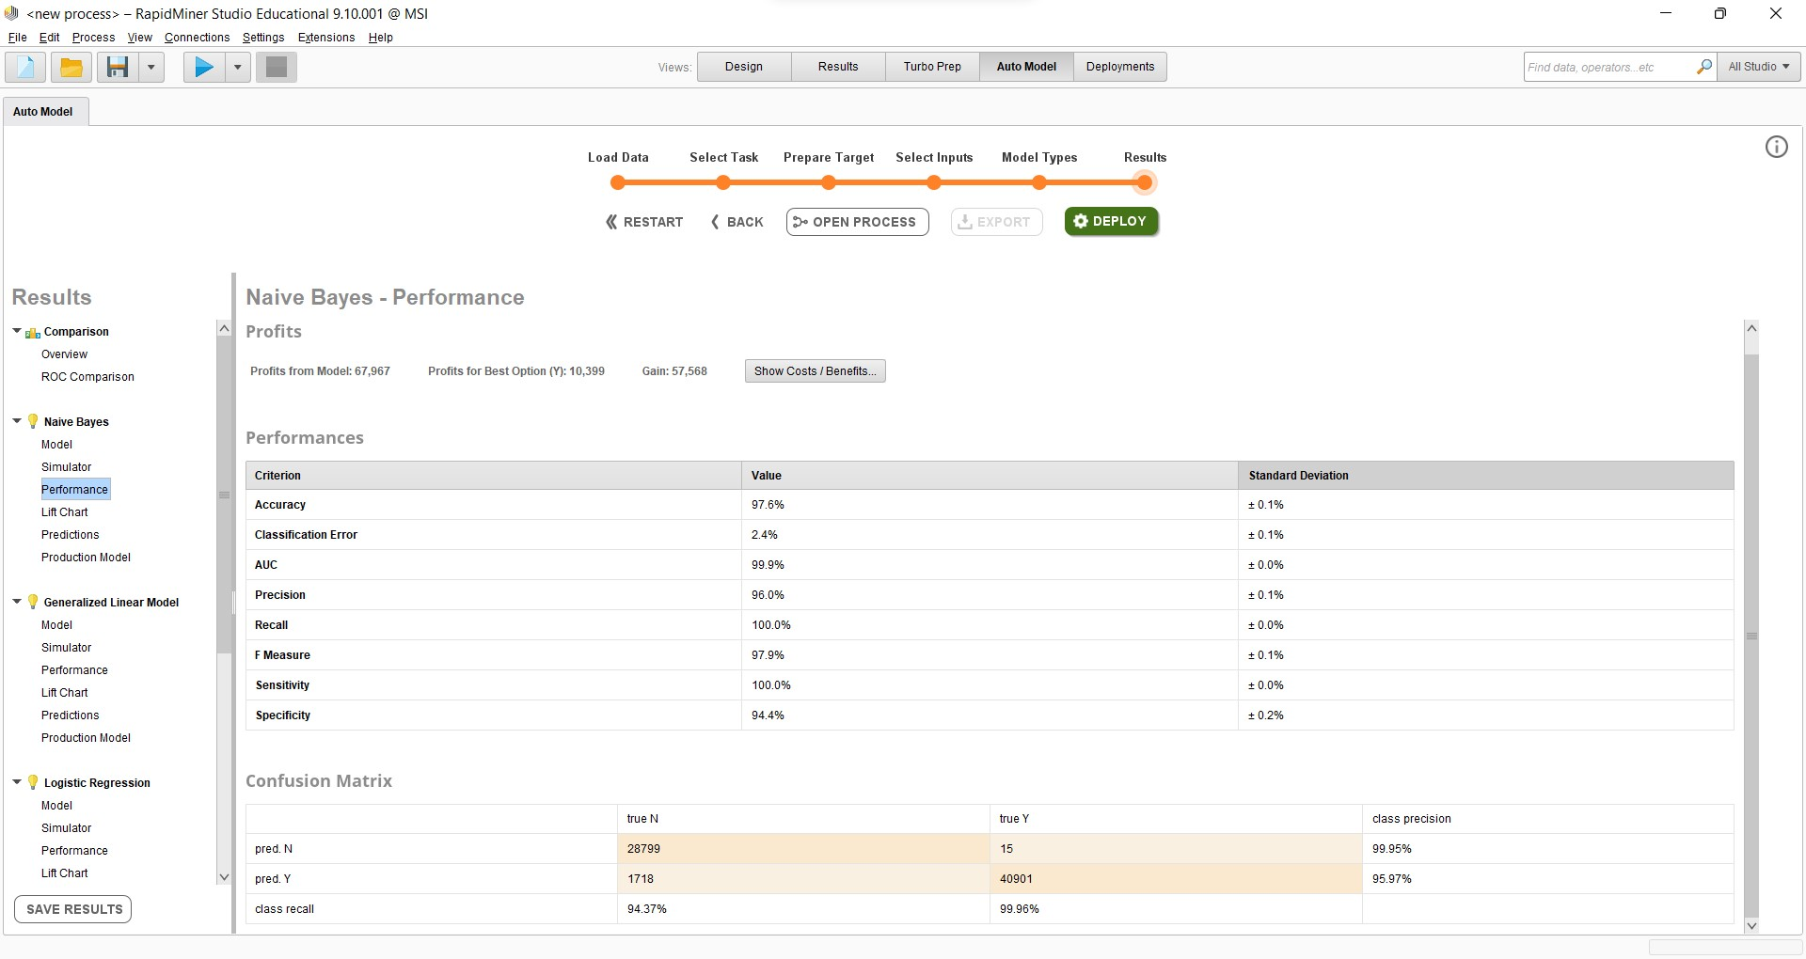

Slide 35


Slide 36
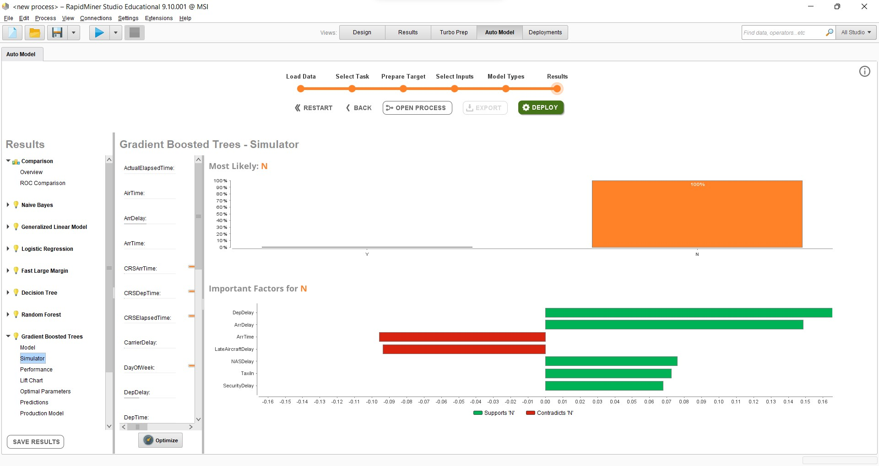
XGB

Slide 37
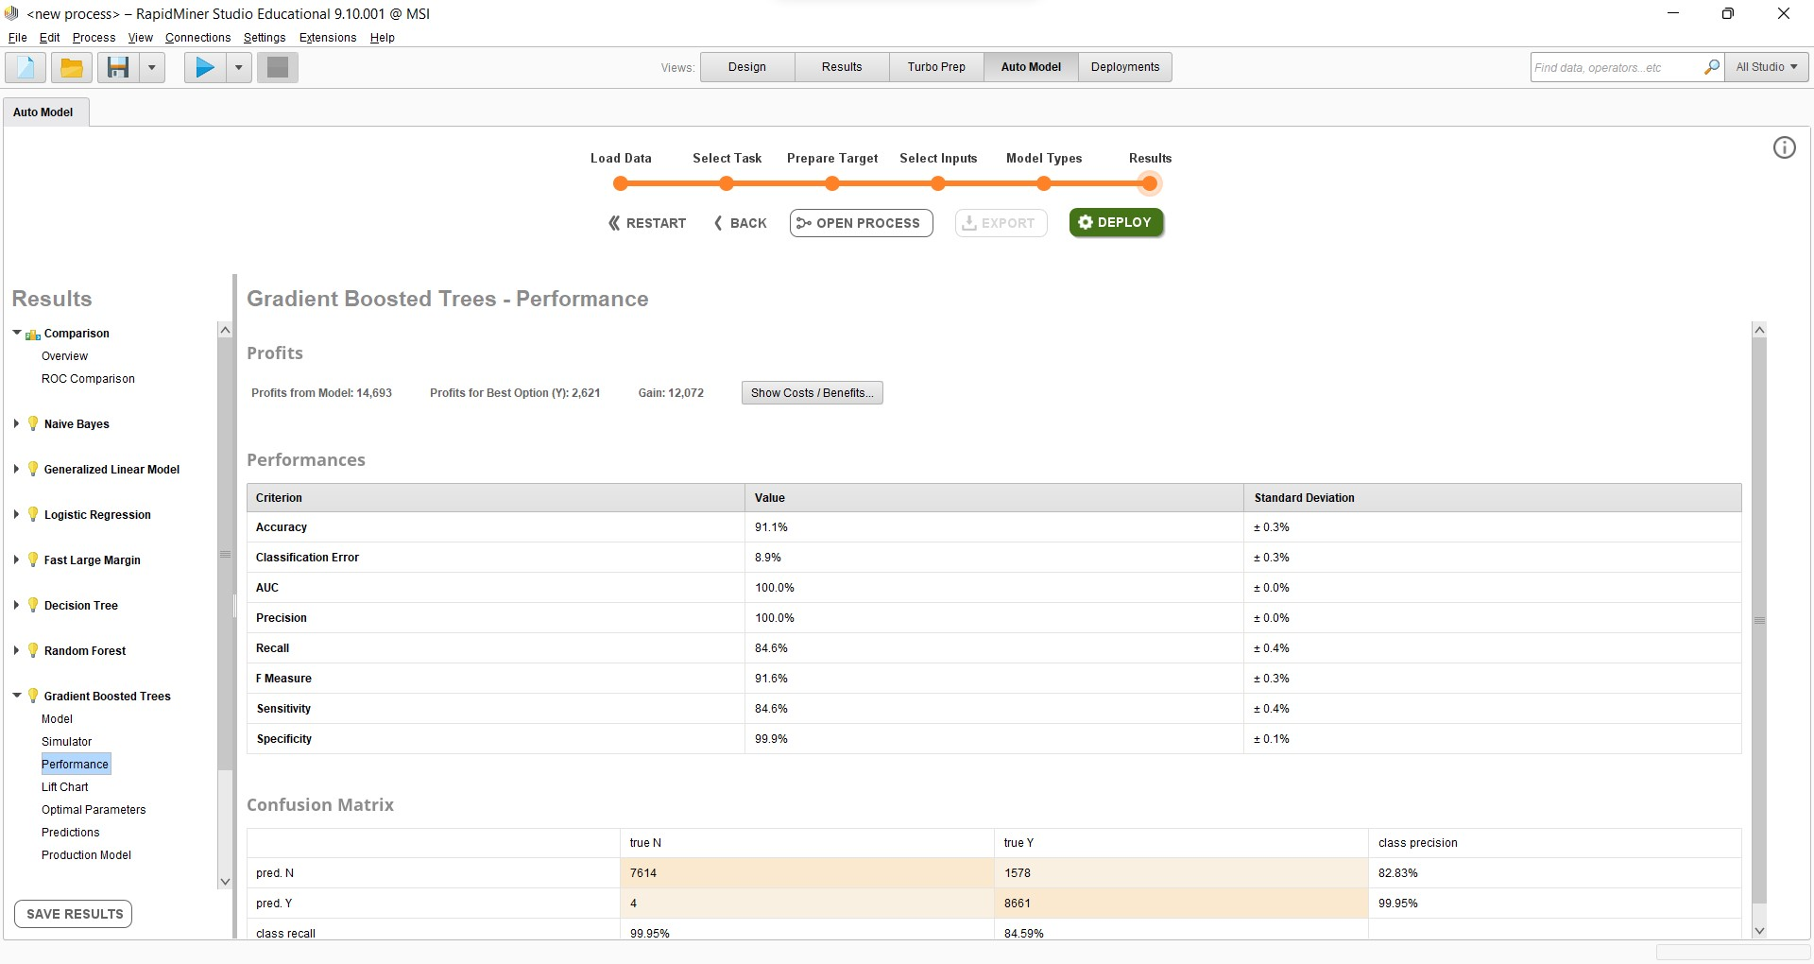

Slide 38


Slide 39
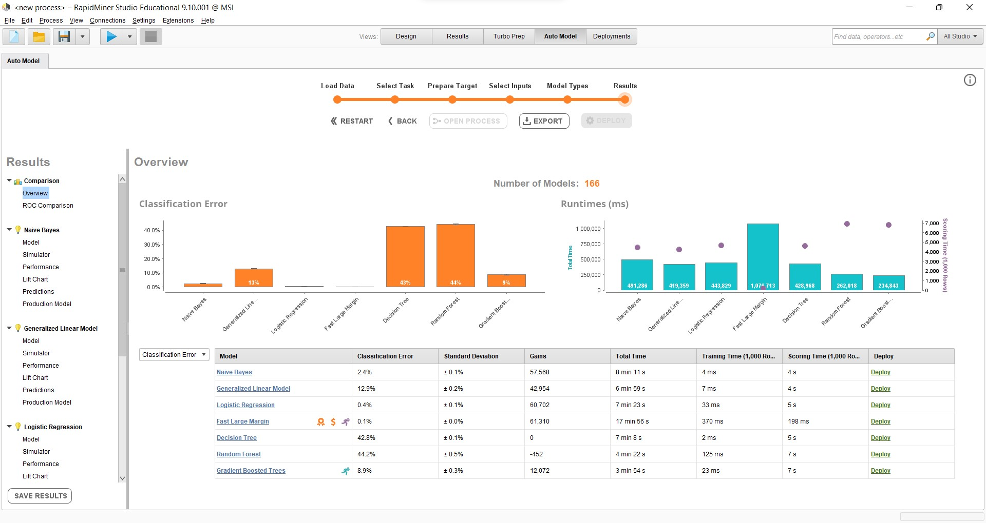
Overview

Slide 40
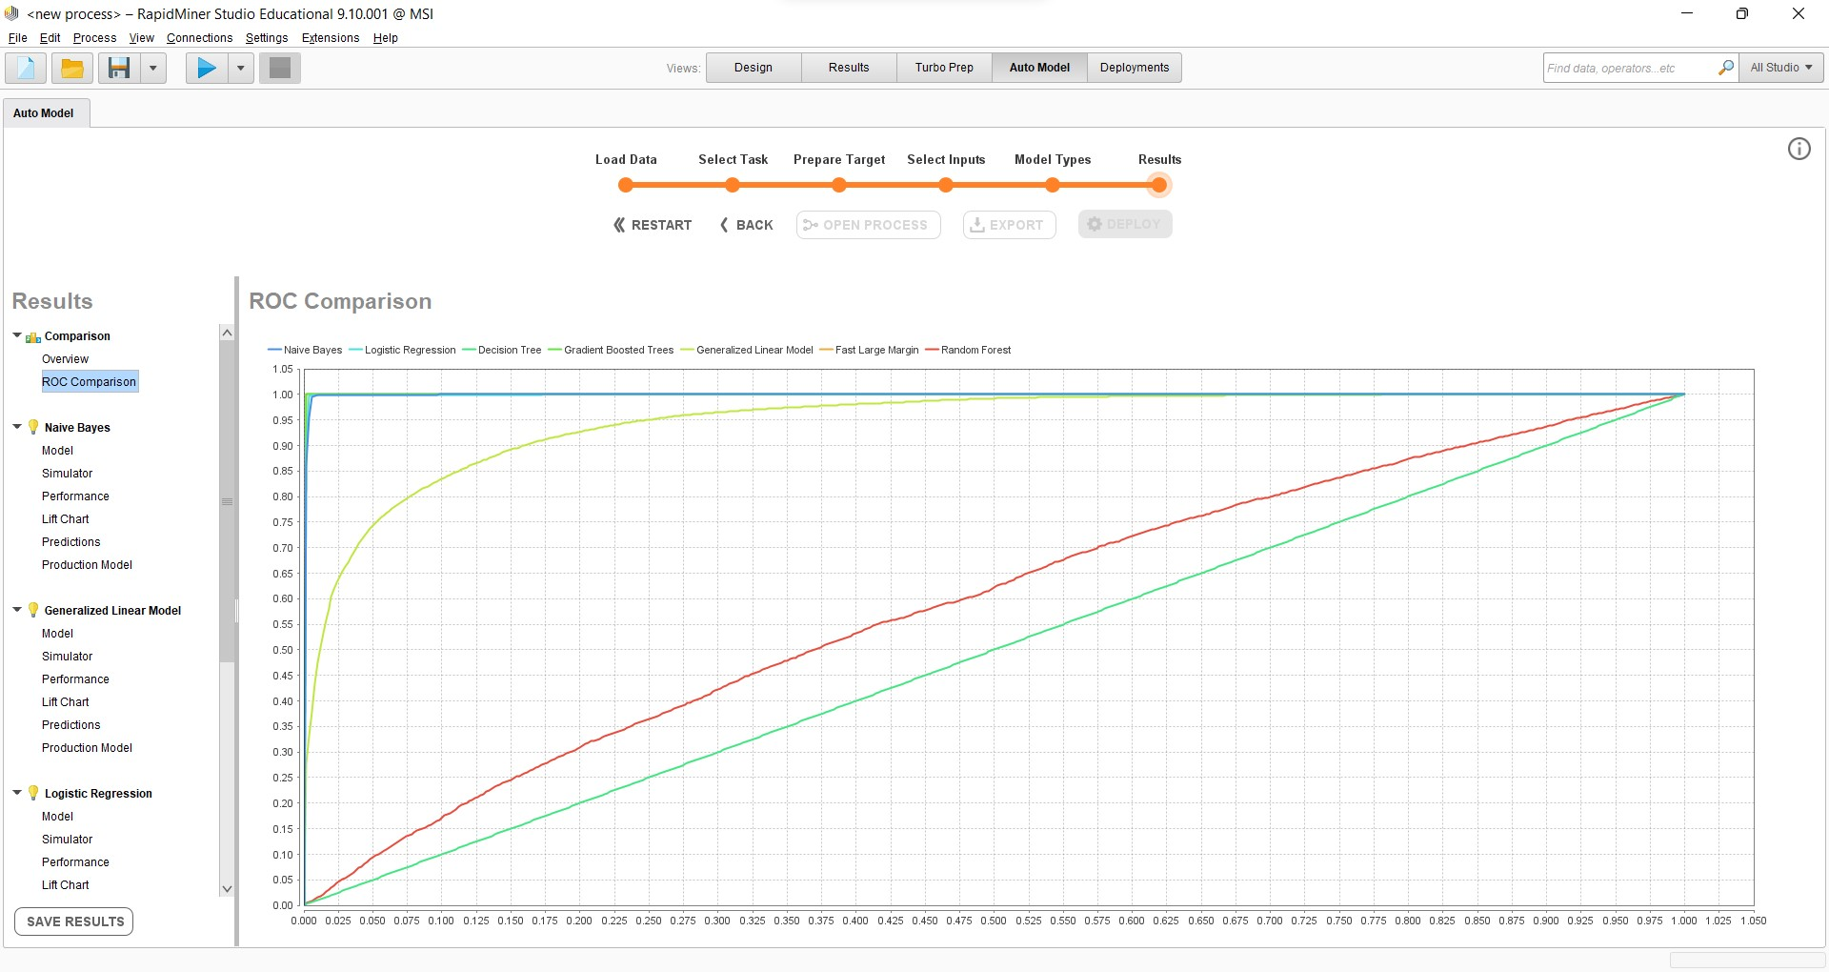
ROC curves comparison

Slide 41
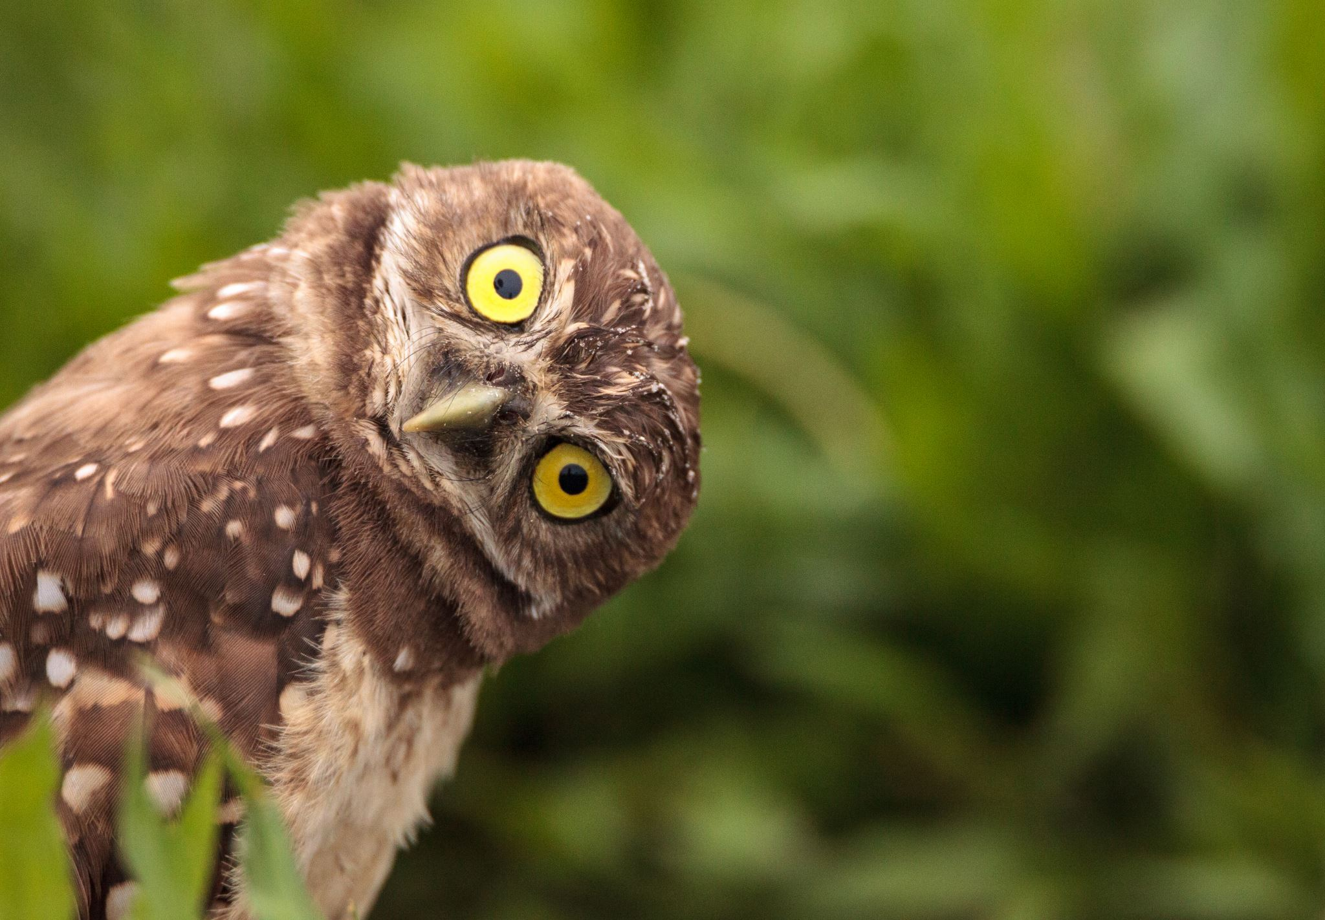
Results
Testing on IBM Auto AI tool and Rapid Miner we got the accuracy of decision tree and XGB model
The accuracy percentage of Fast Large Margin (SVM) and Decision Tree are about the same. We choose XGB (Gradient boosted Trees ) for further procedures as it shows overall accuracy in both tools.

Slide 42
Airlines in year 2022
New flight data file has been provided for year 2022 to predict delays
There are total 12 rows to determine weather flight has been delayed or not.
We used XGB model for the predictions and our previous data in order to find the predictions on year 2022.

Slide 43
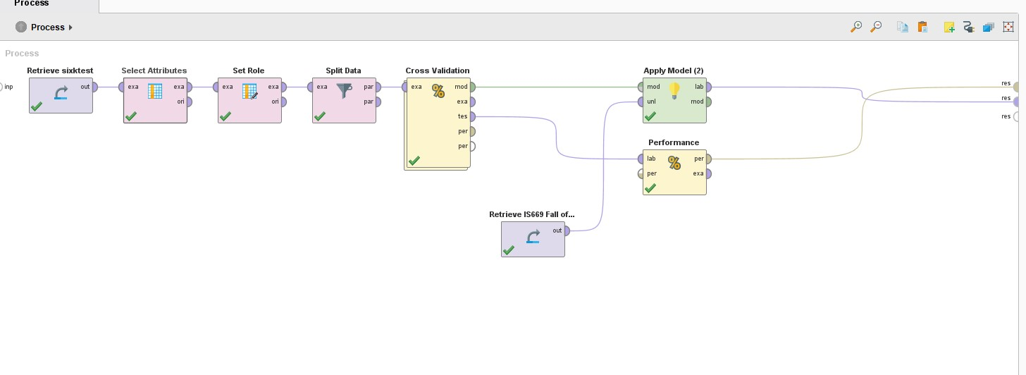
Process

Slide 44
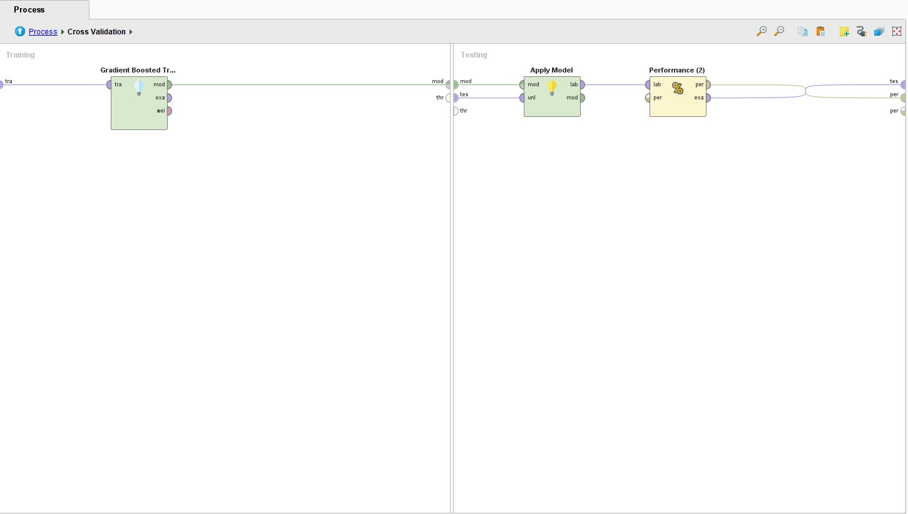
Cross Validation

Slide 45
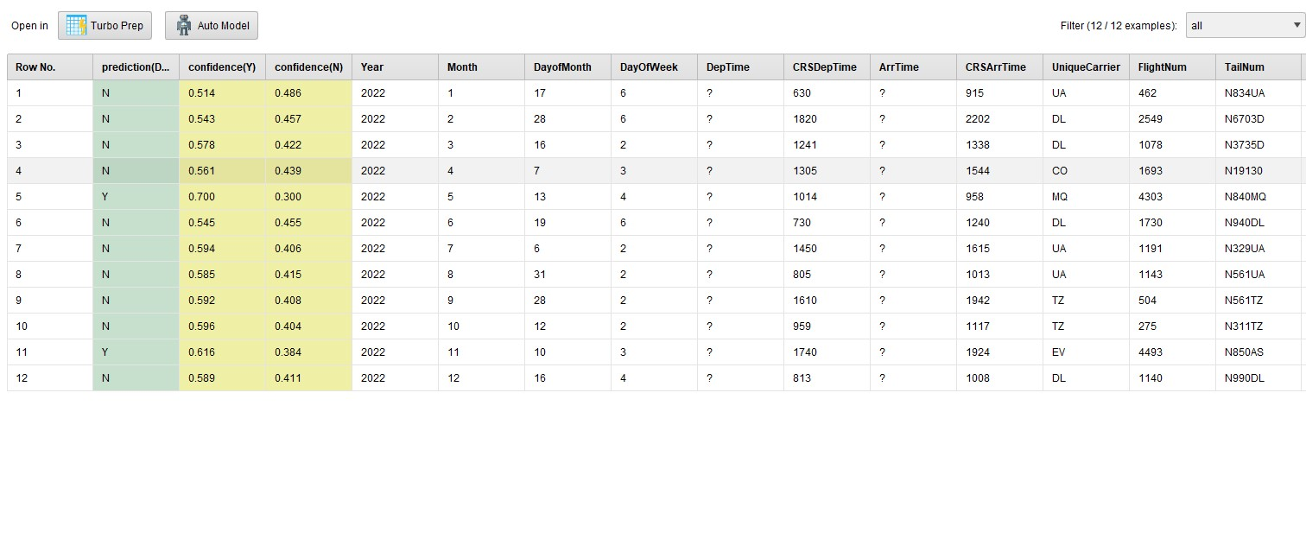
Results (XGB model)

Slide 46
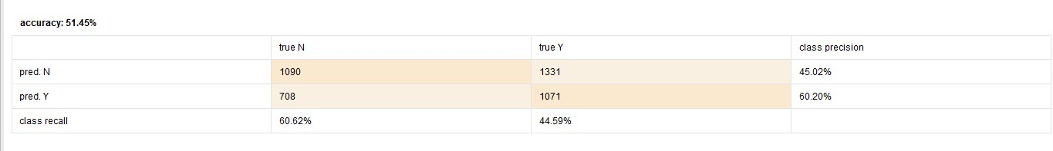
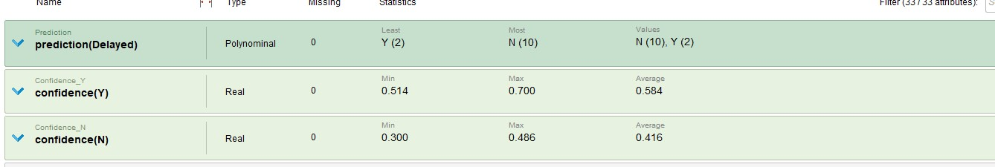

Slide 47
Conclusion
With XGB model and previous data we predicted 10 flights won't be delayed in 2022 and 2 flights will.
XGB model gives us best possible accuracy with accurate predictions.

Slide 48
Thank You

